Slide 1
Animation of Lo Tech Vent showing operation in 4 settings

Slide 2
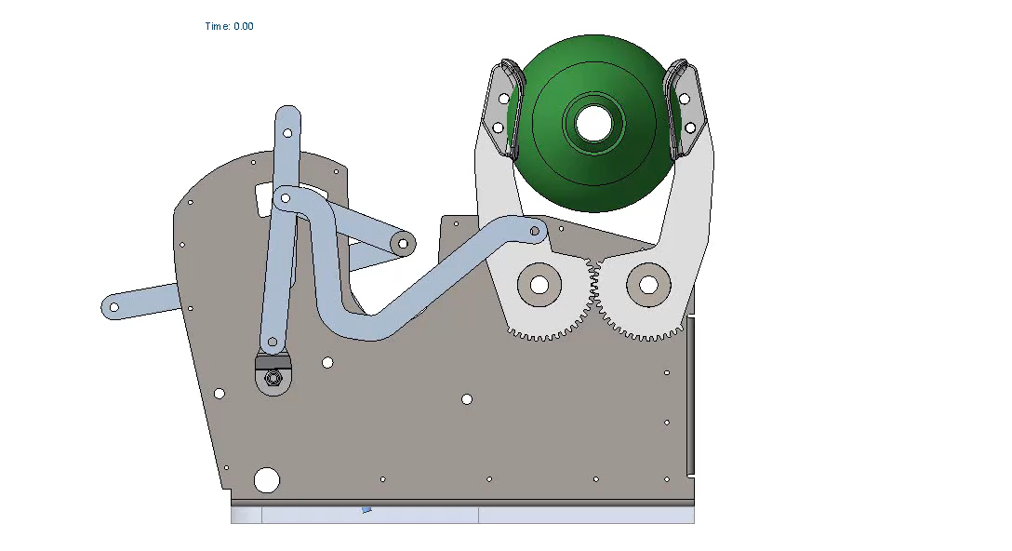
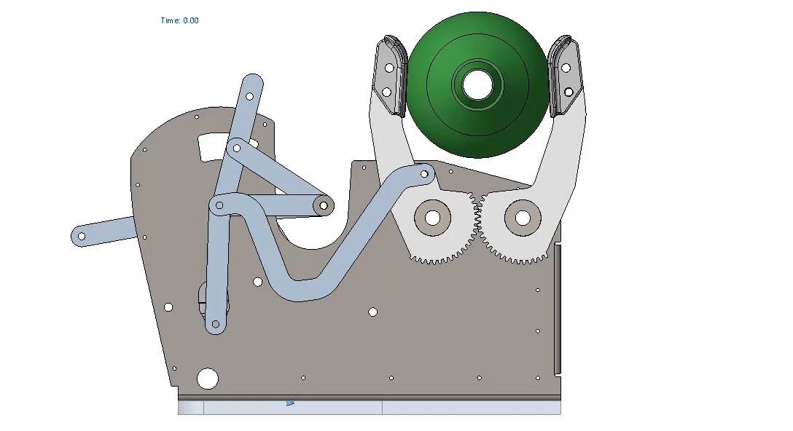
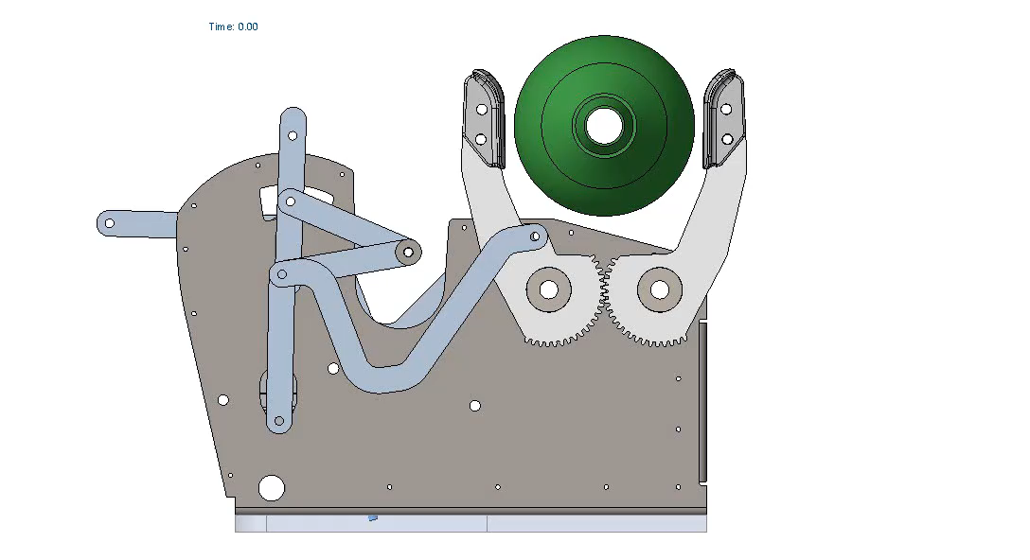
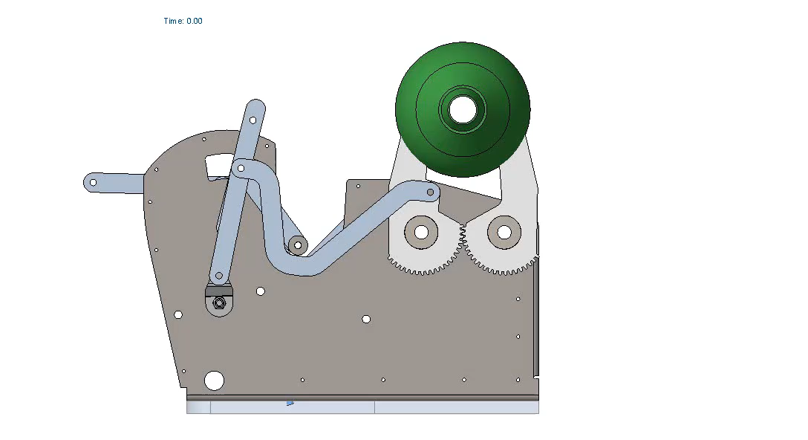
TV=200ml
I/E=1
TV=800ml
I/E=1
TV=200ml
I/E=3
TV=800ml
I/E=3

